Slide 1
Using Pythagoras’ Theorem
Level 7
Longest side
Shorter side
Step 1: Square
Step 1: Square
Step 2: Add
Step 2: Subtract
Step 3: Square Root
Step 3: Square Root
Example 1
Example 3
x
12cm
7cm
x
9cm
7cm
1.
2.
3.
1.
2.
3.
Example 2
Example 4
x
23mm
4cm
15mm
8cm
x
1.
2.
3.
1.
2.
3.

Slide 2
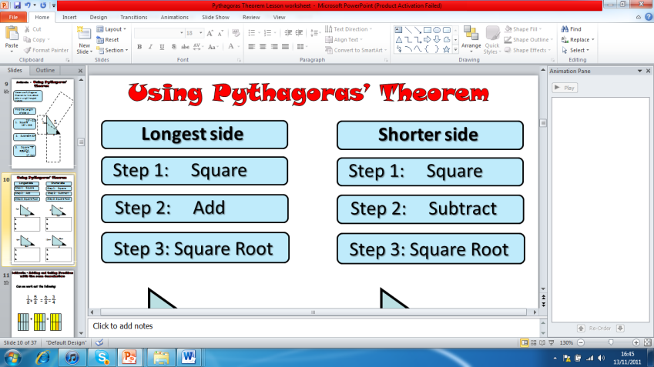
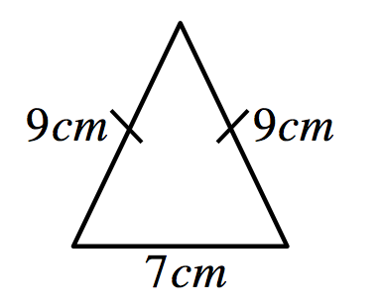
Demonstrate –
Using Pythagoras’ Theorem
Rally Coach
For each of the following triangles, calculate the length of the missing side, giving your answers to one decimal place when needed.
1
2
3
19m
6cm
11cm
14m
3cm
5cm
Level 7
4
5
6
13mm
1.1cm
60cm
1.5cm
12mm
25cm
7
Calculate the length of the diagonal of this square.
8
If a right angle has short lengths 14cm and 8cm, what is the length of the longest side.
6cm
9
10
Calculate the base of this
isosceles triangle.
Calculate the height of this isosceles triangle.
12cm
12cm
Level 8
10cm
10cm
8cm
8cm
I can find missing sides on a right-angled
triangle using Pythagoras’ Theorem:

Slide 3
Consolidate – Pythagoras’ Theorem
Each team-mate has a different real – life problem.
On your own solve each of these problems.
Once you completed, swap with the other pupils on your table and give feedback each others answers
Level 8
Real Life Problem 1
A boat travels 45 miles east then 60 miles north, how far is it from where it started? (hint: draw a diagram)
Answer=_______
I can solve problems using Pythagoras’ Theorem:
Consolidate – Pythagoras’ Theorem
Each team-mate has a different real – life problem.
On your own solve each of these problems.
Once you completed, swap with the other pupils on your table and give feedback each others answers
Level 8
Real Life Problem 2
A swimming pool is 25m by 12m, if someone swam from one corner to the other, how far would they have swam? (hint: draw a diagram)
Answer=_______
I can solve problems using Pythagoras’ Theorem:

Slide 4
Consolidate – Pythagoras’ Theorem
Each team-mate has a different real – life problem.
On your own solve each of these problems.
Once you completed, swap with the other pupils on your table and give feedback each others answers
Level 8
Real Life Problem 3
A ladder which is 4m long leans against a wall, the bottom of the ladder is 1.5m from the bottom of the wall, how high up the wall does the ladder go? (hint: draw a diagram)
Answer=_______
I can solve problems using Pythagoras’ Theorem:
Consolidate – Pythagoras’ Theorem
Each team-mate has a different real – life problem.
On your own solve each of these problems.
Once you completed, swap with the other pupils on your table and give feedback each others answers
Level 8
Real Life Problem 4
A rope of length 10m is stretched from the top of a pole 3m high until it reaches the ground. How far is the end of the rope to the base of the pole. (hint: draw a diagram)
Answer=_______
I can solve problems using Pythagoras’ Theorem:

